Slide 1
Smart contract
on Cardano
Thomas Vellekoop Educator at IOG

Slide 2

What is Cardano?
A 3rd generation blockchain that is:
Proof of Stake
Scalable
Programmable
Governance
Interoperable

Slide 3
What is Cardano?
A 3rd generation blockchain that is:
Proof of Stake
Scalable
Programmable
Governance
Interoperable
EUTxO model

Slide 4
A condensed history of the generations
1st generation:
2nd generation:
Cardano:
UTxO model
Lacked programmability
Account model
VM for programmability
EUTxO model
Plutus

Slide 5

A condensed history of the generations
1st generation:
2nd generation:
Cardano:
UTxO model
Lacked programmability
Account model
VM for programmability
EUTxO model
Plutus

Slide 6

A condensed history of the generations
1st generation:
2nd generation:
Cardano:
UTxO model
Lacked programmability
Account model
VM for programmability
EUTxO model
Plutus

Slide 7

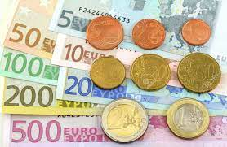
The UTxO model (an analogy)

Slide 8



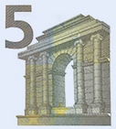
The UTxO model (an analogy)
Your wallet
The shop
Inputs

Slide 9
The UTxO model (an analogy)
Your wallet
Your wallet
Transaction
The shop
The shop
Inputs

Slide 10
The UTxO model (an analogy)
Your wallet
Outputs
Your wallet
Transaction
The shop
The shop
Inputs

Slide 11
The UTxO model (an analogy)
Your wallet
Your wallet
Transaction
The shop
The shop
Value is conserved!

Slide 12
The UTxO model (the real deal)
The Unspent Transaction Output model
A 20 euro bill -> A 20 Ada UTxO
20 Ada

Slide 13
The UTxO model (the real deal)
Your wallet
20 Ada
Your wallet
10 Ada
The shop
The shop
5 Ada
Old unspent outputs

Slide 14
The UTxO model (the real deal)
Your wallet
20 Ada
Your wallet
10 Ada
Transaction
The shop
The shop
5 Ada
Value can be arbitrarily split
Old unspent outputs

Slide 15
The UTxO model (the real deal)
Your wallet
20 Ada
New unspent outputs
Your wallet
5 Ada
10 Ada
Transaction
The shop
The shop
25 Ada
5 Ada
5 Ada
Value can be arbitrarily split
Old unspent outputs

Slide 16
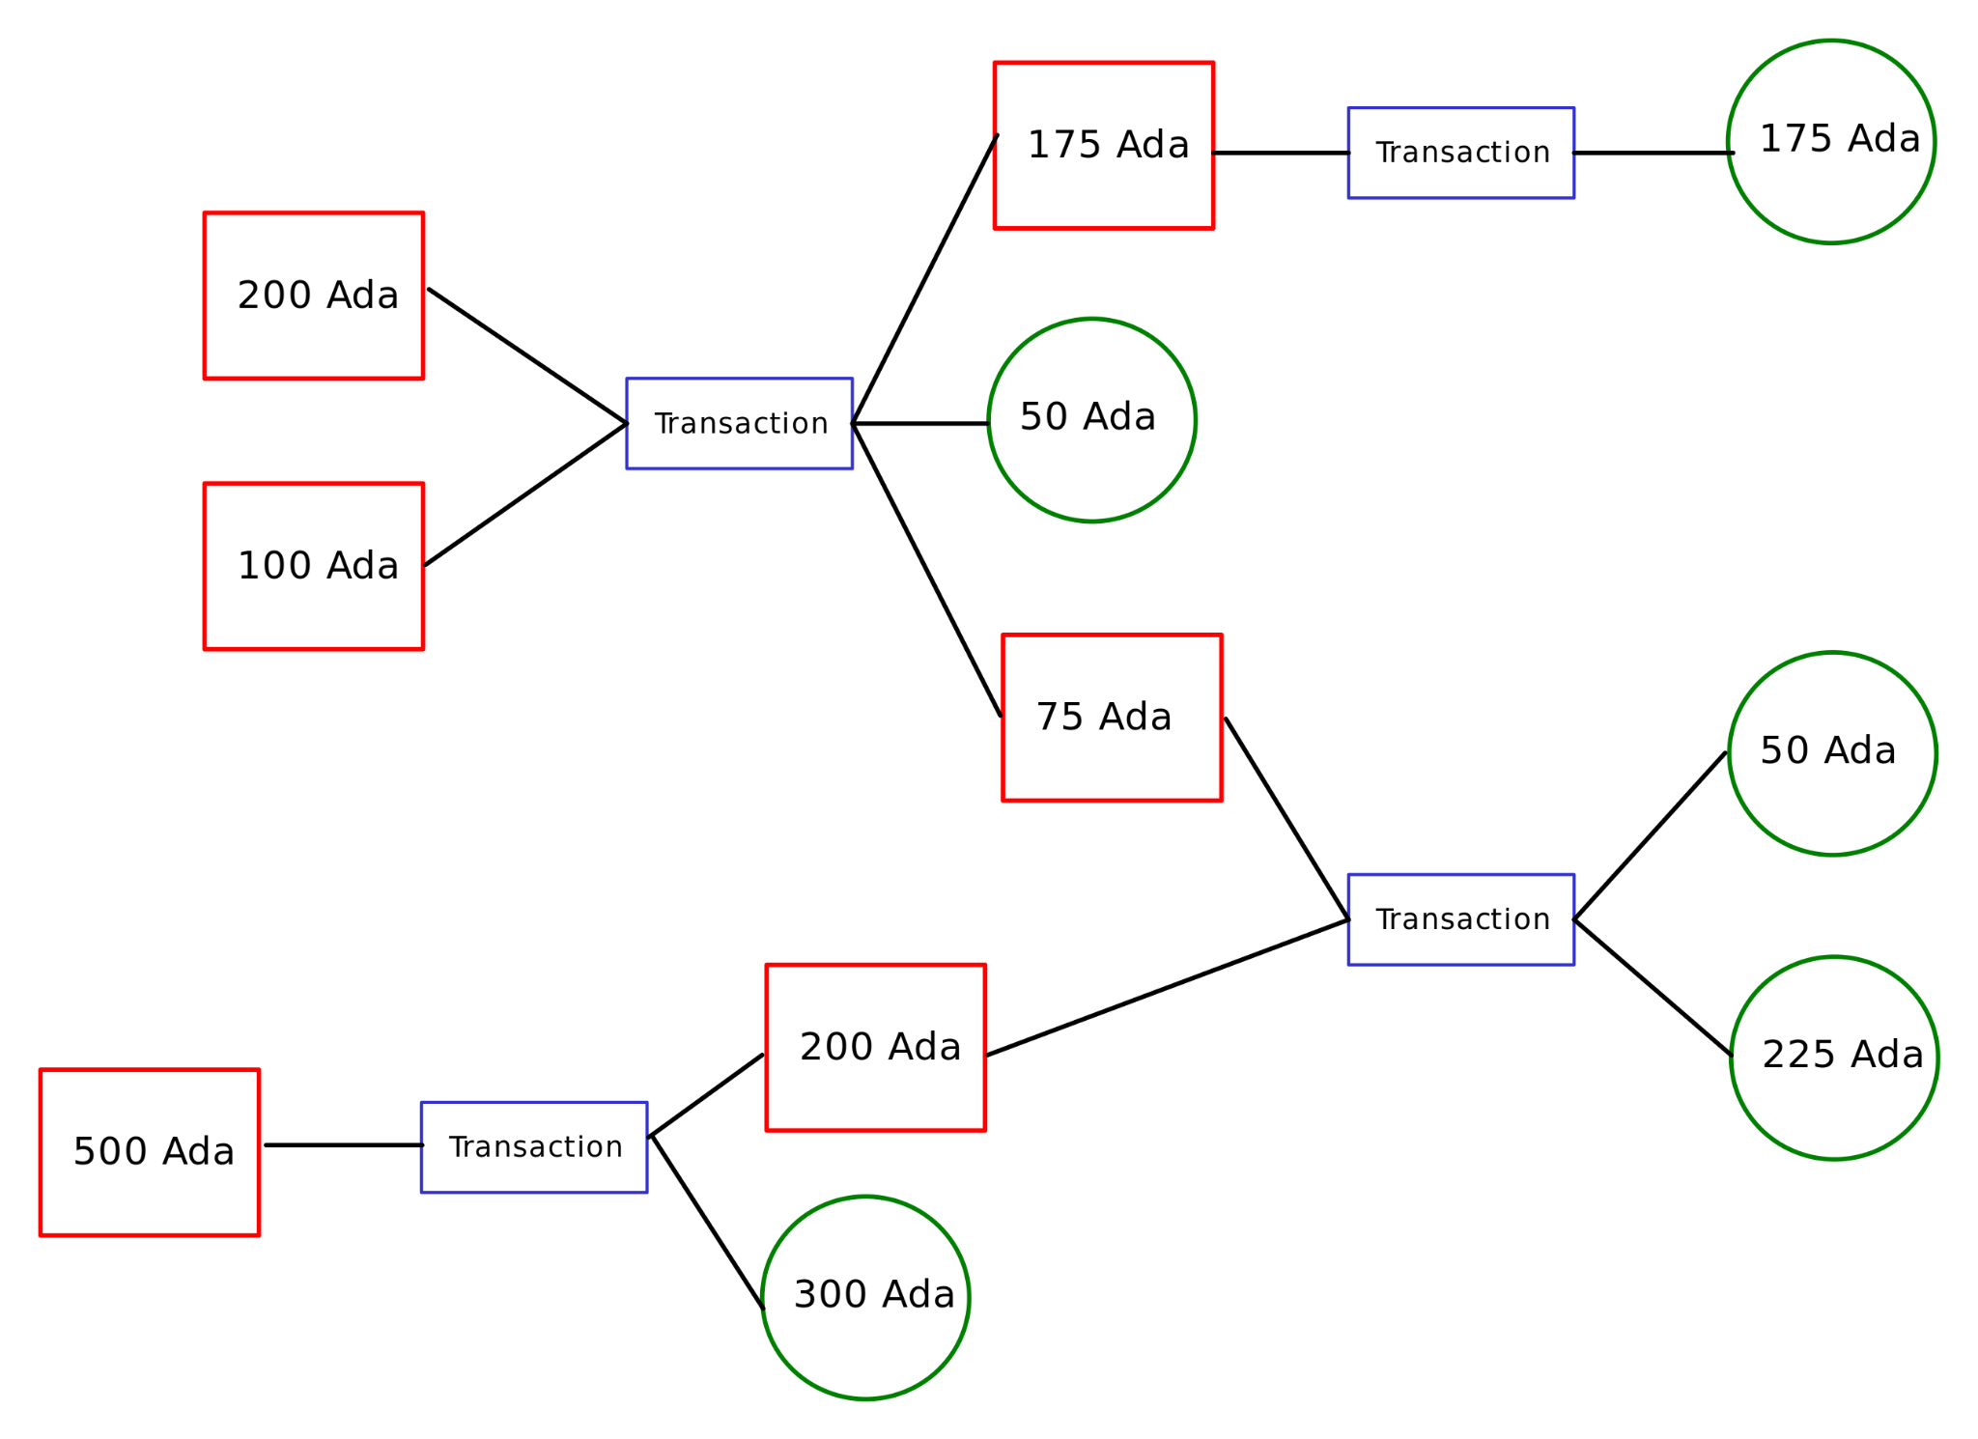
The UTxO model (A bird's-eye view)
Unspent Transaction Output
Representation via a graph
Present (unspent outputs)
Changes (transactions)
The history (spent outputs)

Slide 17
What controls an output?
In the UTxO model:

Slide 18
What controls an output?
In the UTxO model:
UTxO

Slide 19
What controls an output?
In the UTxO model:
UTxO
Address

Slide 20
What controls an output?
In the UTxO model:
UTxO
Address
Transactions must be signed!

Slide 21
What controls an output?
In the UTxO model:
Limits of UTxO model
UTxO
Cannot handle data
Has no conditional logic
Address

Slide 22
What controls an output?
In the UTxO model:
Limits of UTxO model
UTxO
Cannot handle data
Has no conditional logic
It's not expressive!
Address

Slide 23

What controls an output?
In the UTxO model:
Limits of UTxO model
UTxO
Cannot handle data
Has no conditional logic
It's not expressive!
Address
We need a programming language to express for spendability

Slide 24

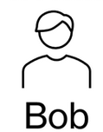
An EUTxO example
1 NFT
20 Ada
10 Ada

Slide 25

An EUTxO example
Smart contract
1 NFT
20 Ada
10 Ada

Slide 26
The extended UTxO model - With an intermediary
Address Bob
20 Ada
10 Ada
Address Alice
1 NFT

Slide 27
The extended UTxO model - With an intermediary
Address Bob
20 Ada
Spendable by a transaction if one or both hold
10 Ada
Address Alice
1 NFT
Contract address

Slide 28
The extended UTxO model - With an intermediary
Address Bob
20 Ada
Spendable by a transaction if one or both hold
Alice is paid at least 25 Ada
10 Ada
Address Alice
1 NFT
Contract address

Slide 29
The extended UTxO model - With an intermediary
Address Bob
20 Ada
Spendable by a transaction if one or both hold
Alice is paid at least 25 Ada
and / or
The transaction is signed by Alice
10 Ada
Address Alice
1 NFT
Contract address

Slide 30

The extended UTxO model - With an intermediary
Address Bob
Address Bob
20 Ada
20 Ada
10 Ada
10 Ada
Address Alice
Address Alice
1 NFT
Transaction
Contract address
Contract address
1 NFT + data

Slide 31
The extended UTxO model - With an intermediary
Address Bob
Address Bob
20 Ada
10 Ada
Address Alice
Address Alice
Transaction
Contract address
Script address
1 NFT + data

Slide 32
The extended UTxO model - With an intermediary
Address Bob
Address Bob
20 Ada
5 Ada
The logic :
10 Ada
Alice paid >= 25 Ada Or Signed by Alice
1 NFT
Address Alice
Address Alice
Transaction
25 Ada
Contract address
Script address
1 NFT + data

Slide 33
The extended UTxO model - With an intermediary
Address Bob
Address Bob
20 Ada
The logic :
10 Ada
Alice paid >= 25 Ada Or Signed by Alice
1 NFT
Address Alice
Address Alice
Transaction
30 Ada
Contract address
Script address
1 NFT + data

Slide 34
The extended UTxO model - With an intermediary
Address Bob
Address Bob
20 Ada
20 Ada
The logic :
10 Ada
10 Ada
Alice paid >= 25 Ada Or Signed by Alice
1 NFT
Address Alice
Address Alice
Transaction
Contract address
Script address
1 NFT + data
Is this a valid transaction?

Slide 35
The extended UTxO model - With an intermediary
Address Bob
Address Bob
20 Ada
20 Ada
The logic :
10 Ada
10 Ada
Alice paid >= 25 Ada Or Signed by Alice
1 NFT
Address Alice
Address Alice
Transaction
Contract address
Script address
1 NFT + data
Is this a valid transaction?
It depends…

Slide 36
The extended UTxO model - With an intermediary
Address Bob
Address Bob
20 Ada
20 Ada
The logic :
10 Ada
10 Ada
Alice paid >= 25 Ada Or Signed by Alice
1 NFT
Address Alice
Address Alice
Transaction
Contract address
Script address
1 NFT + data

Slide 37
Recap
The EUTxO model
Value is captured in unspent outputs (UTxO’s)
Each UTxO needs to provide a witness to be spent
Signature witness
Smart contract

Slide 38
Want to learn more?
Follow the Plutus Pioneer program

